Slide 1


Terminal Based Process RPG
Group 15:
Sarvesh Ram Kumar – CB.SC.U4AIE24048
Adwaidh– CB.SC.U4AIE24003
Nikhileshwara Reddy– CB.SC.U4AIE24063

Slide 2
Introduction :
Project Idea:
Each Process would be considered as a player and it will have its own attributes like Health, Stamina and Attack power.
Each process will take turn in randomly selecting one of the actions and use system calls to gain health, attack or other actions.
Each action would be recorded and displayed to the user through terminal and one process would end up being winner.
System calls that would be used:
File/Directory I/O: open, read, close
IPC: pipe, open, write, read
Process Control: fork, kill, getpid

Slide 3
Game Mechanics (Process Battle Simulator) :
Players as Processes
  The game creates two processes using fork(). Parent Process = Player 1 . Child Process = Player 2
Turn-Based Combat
Each player takes turns to perform an action. Actions are chosen randomly:
  Attack → Inflicts 1–20 damage on the opponent.
  Heal → Restores 1–15 HP to self.
Inter-Process Communication (IPC)
  A pipe connects the parent and child processes.
  Player 2 sends its chosen move to Player 1 through the pipe.
  Player 1 executes both moves (its own + the one received).
Health Tracking
Each player starts with 100 HP. HP cannot exceed 100 (after healing). HP cannot drop below 0 (after taking damage). Each move (attack/heal) is written into a file battle_log.txt using open(), write(), and close(). This creates a permanent battle record that can be reviewed after the ga
Victory Condition
  The battle continues until one player’s HP reaches 0. The surviving process is declared the winner.

Slide 4
Core Functionalities and Outcome:
Process Control:
Spawn Player/NPC Processes — create separate processes for each participant using fork.
Identify & Manage Turns — use getpid to know whose turn it is.
Attack or Eliminate a Player — use kill to send signals representing “damage” or termination.
Inter-Process Communication:
Create Communication Channel — use the pipe() system call to set up an unnamed pipe between the parent and child process after fork().
Send Player Actions to Game Master — the child process (Player 2) uses write() on the pipe to transmit its moves.
Receive & Process Actions — the parent process (Game Master + Player 1) uses read() on the pipe to receive Player 2’s moves, apply them to the game state, and manage the battle.
File I/O:
Log Game Events — open a log file and use write to save battle actions.
Review Past Battles — use open + read to display previous game logs.
Outcome : A Fun game simulation where processes (players) communicate via IPC, actions are logged in real time, and past battles can be reviewed from saved logs.

Slide 5
Implementation:
Include headers & define constants
Standard libraries included for I/O, process control, and file handling. MAX_HEALTH constant set to 100.
Define Move struct
Holds info about a player’s action: attacker, damage, heal.
Player action function (player_action) : Randomly decides whether the player attacks or heals.
Attack → random damage (1–20).
Heal → random heal (1–15).
Logging function (log_move)
Opens/creates battle_log.txt. Appends a message describing the move (attack or heal).
Create pipe for IPC
pipe(pipefd) creates an unnamed pipe. Enables communication between parent and child processes.
Fork process
Child process = Player 2. ChildParent process = Game Master + Player 1.
Process (Player 2)
Closes read end of the pipe. Continuously generates moves with player_action().
Sends moves to parent through write(pipefd[1], &move, sizeof(Move)).
Parent process (Player 1 + Game Master)
Closes write end of the pipe. Runs game loop while both players’ health > 0. Executes Player 1’s move locally (attack reduces P2 health, heal increases P1 health). Logs move and prints health. Reads Player 2’s move from pipe using read(). Updates health accordingly and logs it.
Game termination Loop ends when either player’s health ≤ 0. Parent announces the winner (Player 1 wins! or Player wins!).

Slide 6
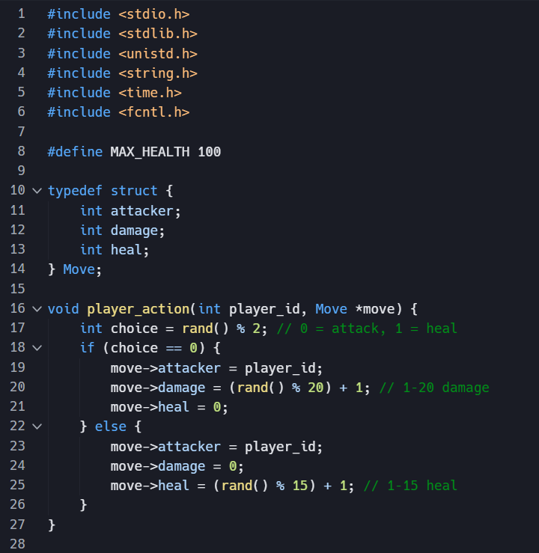
Game Mechanics : Process Actions :
Process Actions:
rand() % 2 randomly picks 0 or 1.
If 0 → player attacks, if 1 → player heals.
Attack case:
Save attacker ID. No healing.
Assign random damage between 1–20.
Heal case:
Save attacker ID. No damage.
Assign random healing between 1–15.

Slide 7
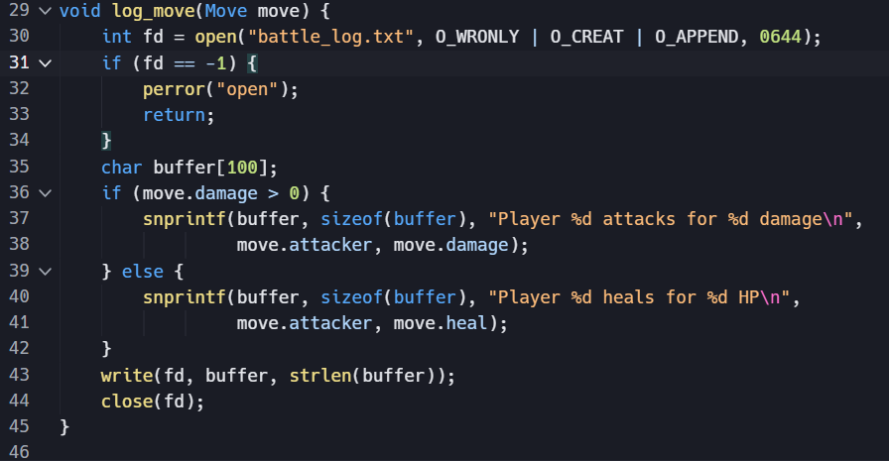
Game Mechanics : Moving:

Slide 8
Thank You

